Slide 1

Seasonal Agriculture Performance Analysis
Major Project – Data Visualization
Student: Varsha R K
BHARATHIDASAN UNIVERSITY
AICTE STU ID STU676ff5cfac83b1735390671

Slide 2

PROBLEM STATEMENT
Agricultural performance is influenced by seasonal environmental conditions, farming practices, resource availability and market conditions. This project analyzes the provided agricultural dataset to identify seasonal patterns, trends, relationships and variations.
• Understand variations in agricultural performance
• Identify important seasonal trends
• Compare performance across different periods
• Examine resource and environmental differences
• Support evidence-based agricultural planning
Project Focus
Seasonal comparison Performance trends Resource usage Environmental conditions Economic outcomes

Slide 3
PROJECT DESCRIPTION
A focused real-world data analytics project that explores how agricultural performance changes across seasons.
• Explore and understand the dataset
• Clean and prepare data for analysis
• Analyze seasonal differences
• Compare relevant crops, regions or categories
• Investigate relationships between conditions and outcomes
• Develop evidence-based conclusions and recommendations
1
Data Exploration
2
Cleaning
3
EDA
4
Visualization
5
Insights

Slide 4

WHO ARE THE END USERS?
Farmers & Stakeholders
Agricultural Planners
Understand seasonal performance and resource variation.
Use seasonal trends for planning and comparison.
Researchers
Students & Data Analysts
Study environmental and agricultural relationships.
Practice cleaning, EDA, visualization and interpretation.

Slide 5

TECHNOLOGY USED
Python
Pandas
NumPy
Core analysis
Cleaning & aggregation
Numerical operations
Matplotlib
Seaborn
Jupyter Notebook
Charts
Statistical visualization
Analysis documentation

Slide 6
RESULTS
Seasonal Performance Comparison
Key Finding
Kharif: Yield 5.64 t/ha | Water efficiency 5.89 Rabi: Yield 5.08 t/ha | Water efficiency 5.19 Zaid: Yield 4.67 t/ha | Water efficiency 4.41
Kharif has the highest average yield (5.64 t/ha), while Zaid has the lowest (4.67 t/ha).
Interpretation
• Kharif leads average yield among the three seasons.
• Average yield ranges from 4.67 to 5.64 tonnes/ha.
• Seasonal conditions are therefore associated with measurable differences in agricultural performance.

Slide 7
RESULTS
Production & Economic Results
Kharif
Production: 82,388 t Avg Profit: ₹178,915
Avg Revenue: ₹710,719 Farms: 1,779
Rabi
Production: 67,499 t Avg Profit: ₹87,689
Avg Revenue: ₹601,526 Farms: 1,627
Zaid
Production: 23,098 t Avg Profit: ₹-24,805
Avg Revenue: ₹519,172 Farms: 594
Key finding
Kharif has the highest total production (82,388 tonnes) in the dataset.

Slide 8
RESULTS
Regional Yield Results
1. Punjab
6.12 tonnes/ha
Observation
2. Karnataka
5.73 tonnes/ha
Punjab records the highest average yield among states at 6.12 tonnes/ha. The regional comparison shows that performance is not uniform across locations.
3. Gujarat
5.70 tonnes/ha
4. Telangana
5.08 tonnes/ha
5. Maharashtra
5.03 tonnes/ha

Slide 9
RESULTS
Relationships with Crop Yield
Water_Efficiency_t_per_1000m3
r = 0.915
Key Finding
Production_Tonnes
r = 0.885
Water efficiency has the strongest positive correlation with yield (r = 0.915). Correlation indicates association, not causation.
Profit_INR
r = 0.490
Revenue_INR
r = 0.434
Water_Used_m3
r = 0.389

Slide 10
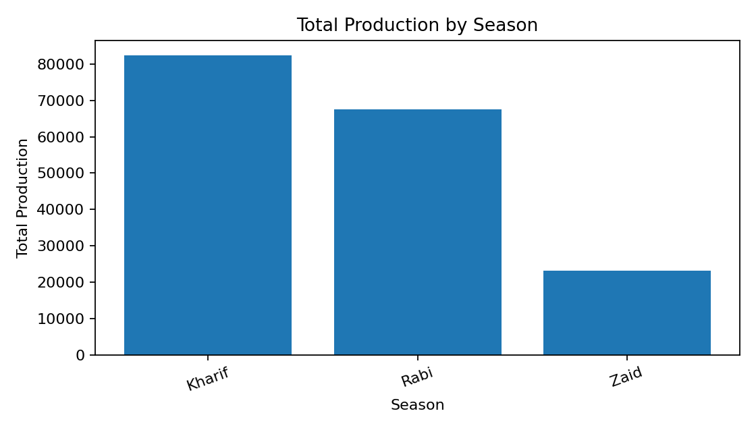
RESULTS
Total Production by Season
Production totals provide a second view of seasonal agricultural output.
Dataset snapshot
Records: 4,000 Variables: 28 Missing cells: 120

Slide 11
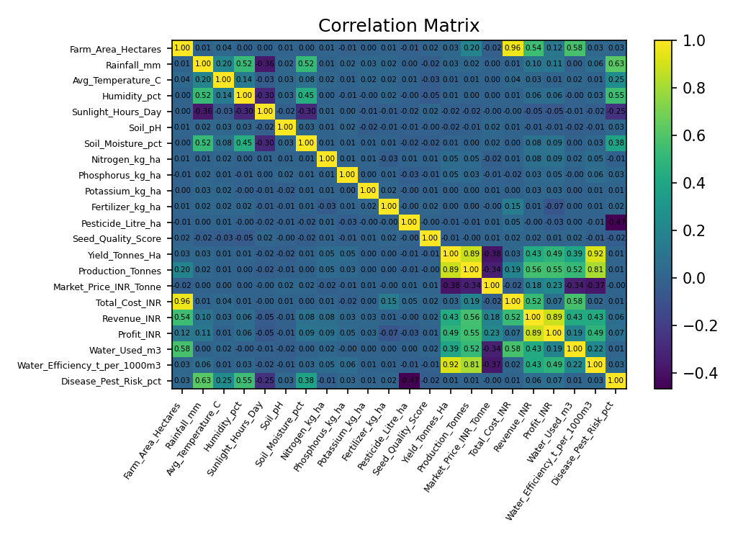
RESULTS
Correlation Matrix
Correlation analysis helps identify relationships among measurable agricultural variables.
Dataset snapshot
Records: 4,000 Variables: 28 Missing cells: 120

Slide 12
FUTURE SCOPE
• Predictive modelling to forecast yield, production and profit for future seasons.
• Longitudinal studies to track seasonal changes over multiple years.
• Comparative analysis across states, districts and crops.
• Resource-efficiency analysis using water, fertilizer and pesticide usage.
• Integrate additional weather, soil and market datasets for richer insights.
These extensions can support more targeted and evidence-based seasonal agricultural planning.

Slide 13
GITHUB LINK
Project GitHub repository:

Slide 14

VOIS COURSE COMPLETION CERTIFICATE
Course Name: Data Visualization

Slide 15
Thank You

